Slide 1
Bike Hiring
Md. Khalid Hasan Haidar
ID: 151-35-955
Department of Software Engineering,
Daffodil International University

Slide 2
Introduction
The system is online Bike Hiring. Here riders are first allowed to register on the site and also login using registered details. Rider can saw different type of bike list & bike details. Then rider can hiring bike as they choose bike. When they book bike then system check is user login or not. If not login then user must login in the system. When rider book bike then its pending request because an admin approval need to approve the request. if approve or reject then message goes to the rider. Also user can post a testimonial about bike.

Slide 3
Objectives of the Project
It is a system design specially for large, premium and small bike hiring business.
The hiring bike system provides complete functionality of listing and booking bike.
In this system, Tourism and Travelling facilities also provide.

Slide 4
Features
Register to the portal
Login
Admin Can Vehicle post
Admin Can update vehicle post
Hirer Request Approve
Show rider list
Rider can Create account
View Bike List
Search Bike List
Request for hiring
User can show profile

Slide 5
Users
Two types of users:
Rider
2. Admin

Slide 6
USER SPESIFICATION
Admin : Admin can add a bike, manage booking car and rent and also view feedback and enquiry. Can also approve hiring request from user.
user : User can view information of bike, booking bike, easily get the bike on rent and also give feedback and can enquiry.

Slide 7
Platform
Platform: website
Front End: html5, css3, bootstrap
Back End: php, Microsoft Sql Server 2008
Other Tools: MS Office 2007, draw.io

Slide 8
HARDWARE REQUIREMENT
Client side:
RAM 512 MB
Hard disk 10 GB
Processor 1.0 GHz
Server side:
RAM 1 GB
Hard disk 20 GB
Processor 2.0 GHz

Slide 9
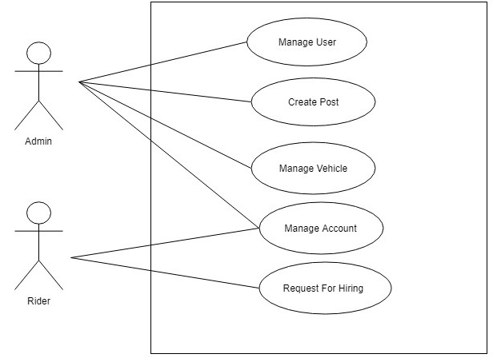
Use Case

Slide 10
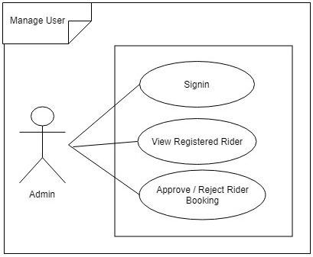
Manage User

Slide 11
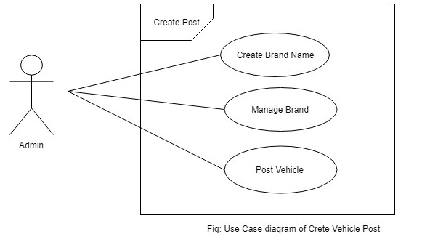
Create Post

Slide 12
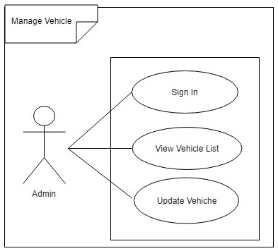
Manage Vehicle

Slide 13
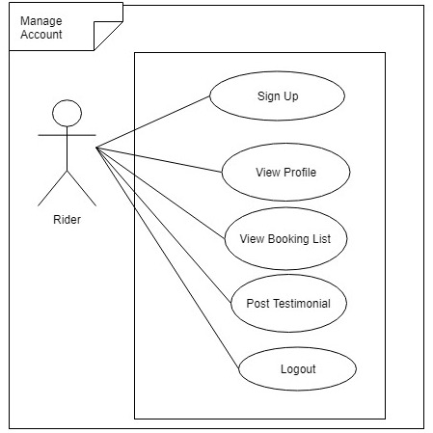
Manage Account

Slide 14
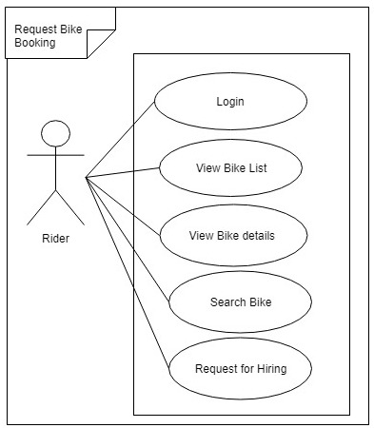
Bike Hiring Request

Slide 15
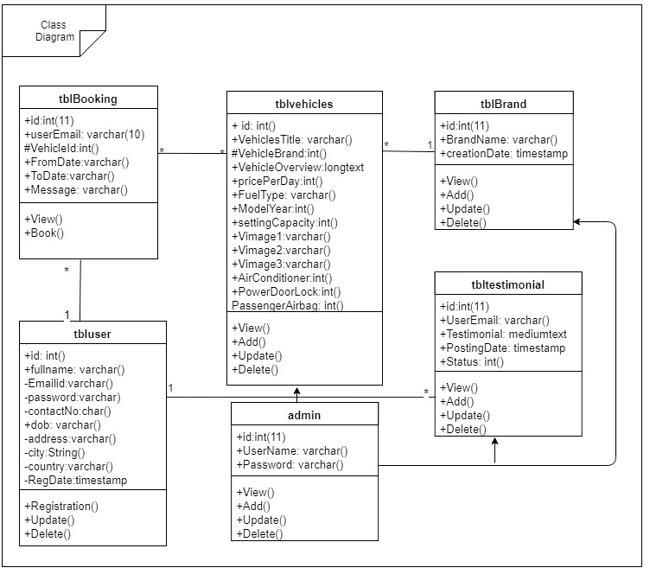
Class Diagram

Slide 16
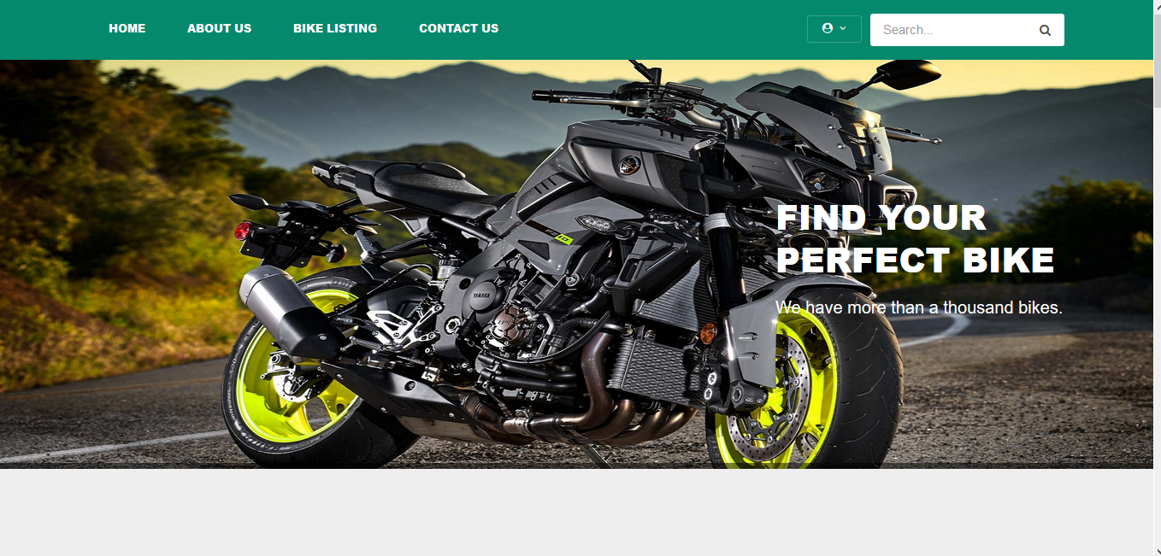
Overview

Slide 17
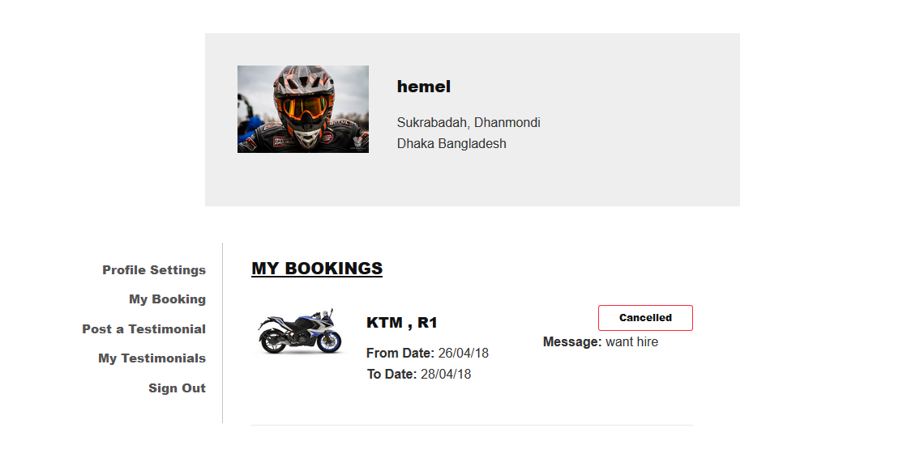
User panel

Slide 18
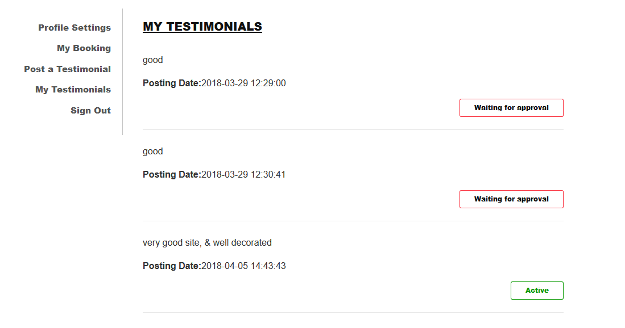
User panel

Slide 19
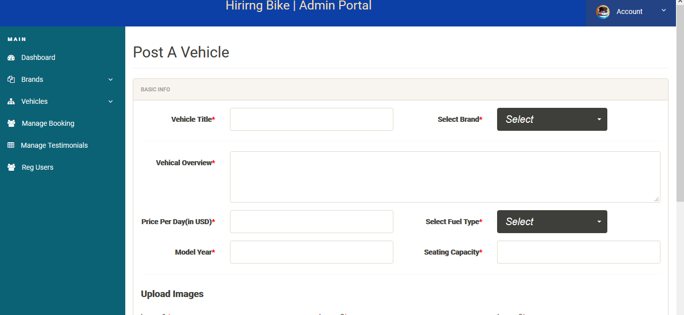
Admin Panel

Slide 20
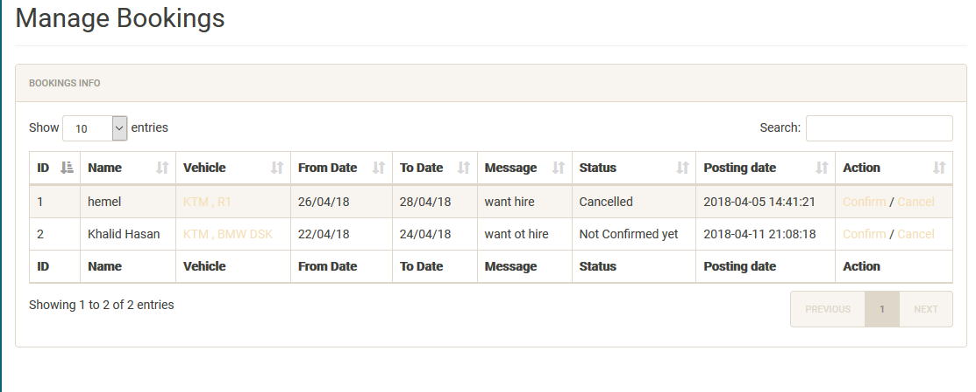
Admin Panel

Slide 21
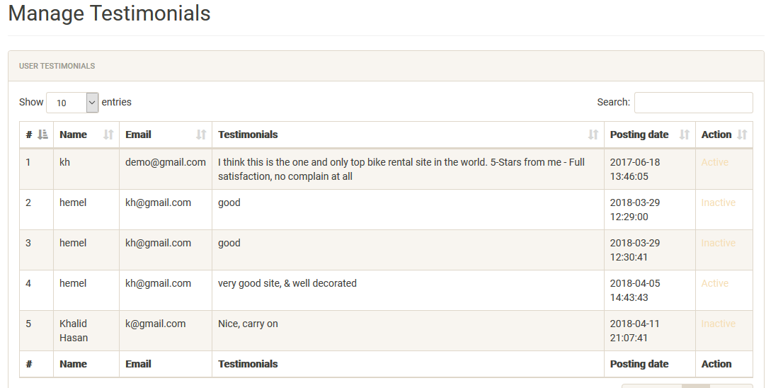
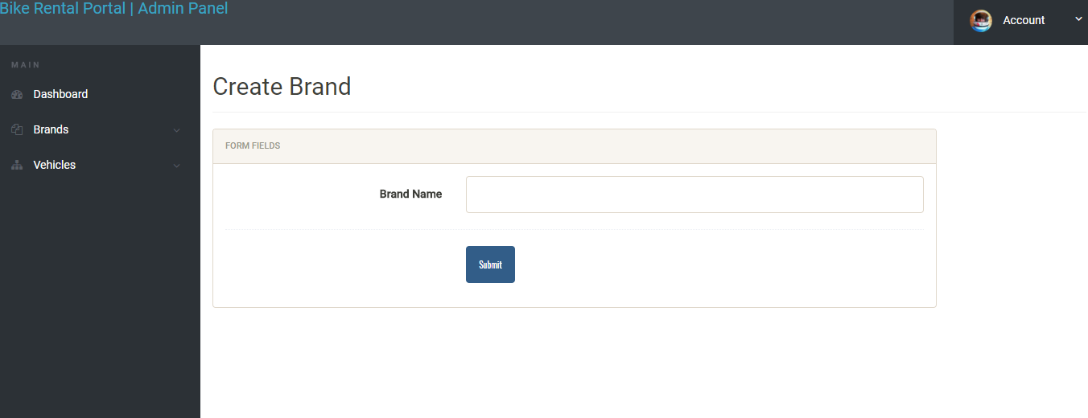

Slide 22
Budget
At least Fifty thousand taka .

Slide 23
FUTURE ENHANCEMENT
Add new bike from is represent the bike list.
The User payment for the current receipt of the payment.(like: bkash, DBBL etc)
Add the current project for booking easy.
Any one can post bike, as they want to given hire.
GPS system

Slide 24
Thank You

